Slide 1
Exploring Non-Local Effects Of Parameter Updates in Deep Q-Learning
6.8200
Kavya Anbarasu
Carol Jiang
Puja Balaji
Kairo Morton

Slide 2
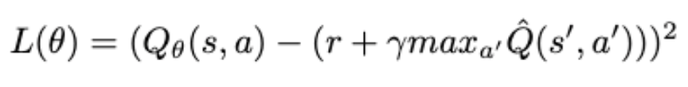
Introduction
investigate how deep Q-network updates for some state-action pairs change Q-values for other state-action pairs
parameter changes:
activation function (ReLU)
state representation (one-hot)
replay buffer (10000) and batch size (128)
Notes:
We’re investigating how updates for deep Q networks for some state-action pairs change the Q-values for other pairs. To do this, we start with a Tabular Q-learning approach to give us a baseline for rest of our experiments. For our project, we are investigating various parameter changes including…

Slide 3


Experiment Setup
OpenAI's FrozenLake-v1 environment (8x8)
baseline experiments
tabular Q-learning
deep Q-learning (ReLU, one-hot state, 10k buffer size, 128 batch)
metrics:
mean absolute error (MAE) of Q-values pre- and post-update
optimality score (OS) for update directions
Notes:
We used OpenAI's gym FrozenLake-v1, a sparse reward environment, which is an 8x8 grid consisting of 64 states and 4 possible actions
To answer our question of whether parameter changes affect distant states, we record two distinct metrics separately for in-batch and out-of-batch state-action pairs during training. First, we record the mean absolute error (MAE) between Q-values before and after a gradient update step. This metric aims to determine if there are differences in the magnitude of Q-value updates for in-batch and out-of-batch state-action pairs.
Second, we compute the optimality of Q-value changes made by the DQN agent for in-batch and out-of-batch (state, action) pairs, assessing the cosine similarity between the actual update directions of state-action pairs and the theoretically optimal update directions

Slide 4
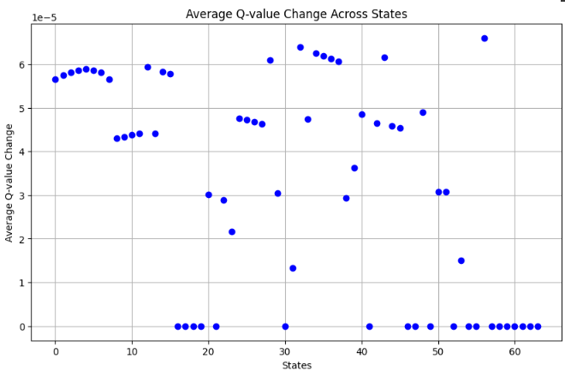
Experiment: Tabular Q-learning (init_q_val=0)
No local or non-local effects in tabular setting
Notes:
In tabular Q-learning, each state-action pair has its own Q-value that is based on immediate rewards and the Q-values of next states. There are no non-local effects because Q-values are updated independently for each state-action pair. As a baseline, when initializing the q-values to zero, the average change in q-value for each state throughout a run ranges from 0 to 7e-5, while the q-values approach 1.

Slide 5
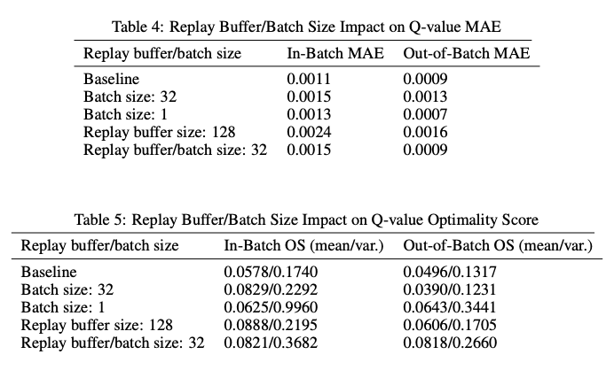
Experiment: Replay buffer/batch size
Notes:
Decreased batch size to 32, 1, decreased replay buffer to 128, 32 to match batch size
observe minimal changes in mae
Batch size 1: high variance in gradient estimates
batch size more of an effect

Slide 6
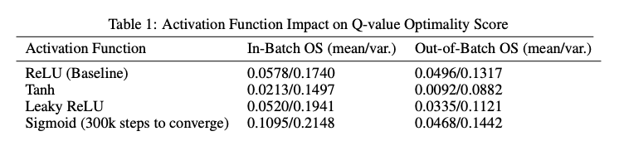
Experiment: Activation function
We found minimal differences in in-batch and out-of-batch MAE values relative to baseline

Slide 7
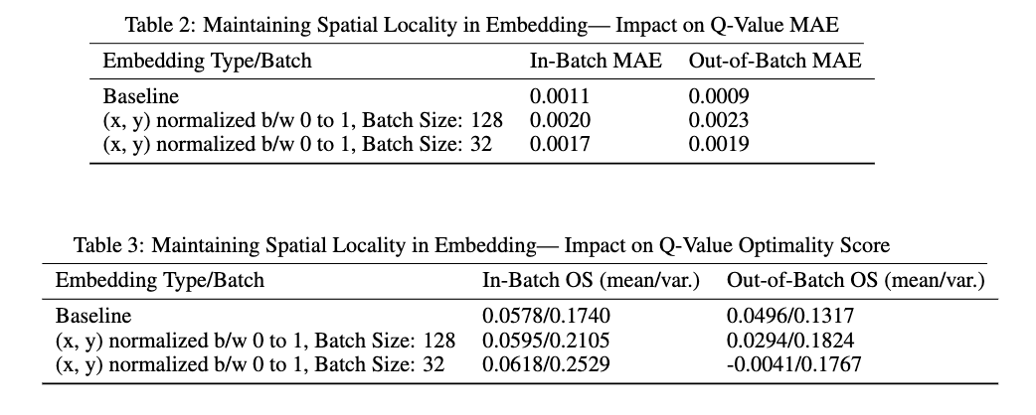
Experiment: State representation

Slide 8
Conclusion/Future Work
similar in-batch and out-of-batch Q-value changes in DQN
state representation and activation function have largest effect on out-of-batch Q-values
better metrics needed
exploration into theory behind parameter changes in DQN
Notes:
We found similar in-batch and out-of-batch Q-value changes in DQN with activation function and state representation contributing the most. In the future, we recommend improving upon the metrics used to evaluate these locality effects by exploring the theory behind parameter changes in deep q-learning.

